Slide 1
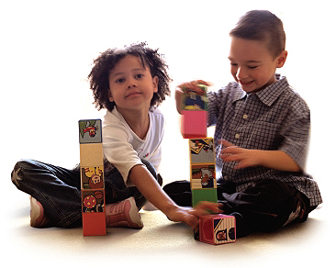







Regional Early Childhood Community Screening
The Sooner We Start- The Farther They’ll Go!
2009-2012

Slide 2
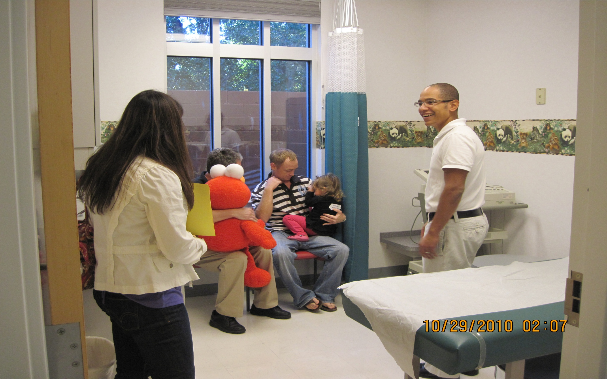
“Early identification of developmental disorders is critical to the well-being of children and their families. It is an integral function of the primary care medical home and an appropriate responsibility of all pediatric health care professionals. American Academy of Pediatrics.”

Slide 3
What We do:
Share information on the importance of developmental screening to families and the general public.
Provide free screening to children 6 months to 5 years.
Screening includes areas of social and emotional development, speech, hearing, dental and overall physical development.
Parents are connected to service agencies that can provide the services needed.

Slide 4
How We do it
Combine resources of Whole Child Social & Emotional Action Team and Capital Area Infant Mental Health.
Secure commitment and resources from agencies and private companies to make it happen. Children’s Medical Services has been a major player in this project.
Utilize community volunteers to fill in the gaps.
Prevent duplication whenever possible by using same screening tools.

Slide 5
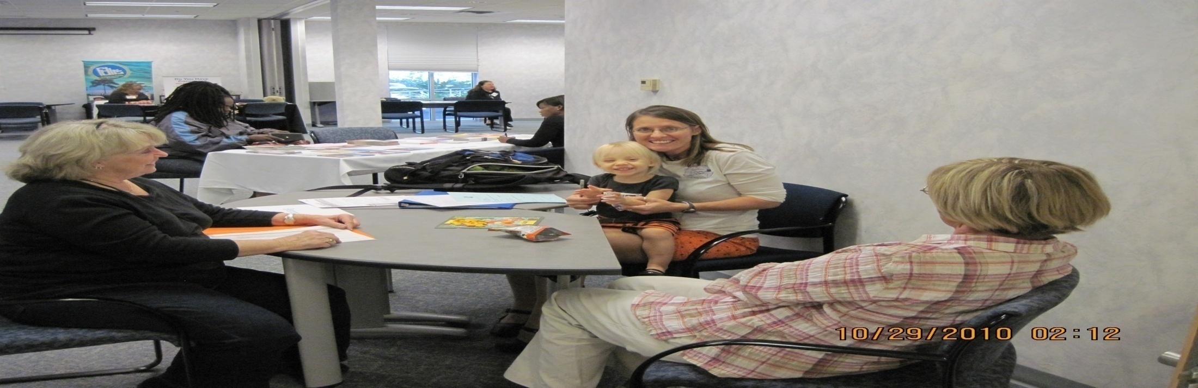

Benefits Of the Screening Events
Benefits Of the Screening Events
Provides the Public with information on the importance of Early Detection and Early Intervention Through Various Media Outlets.
With Parental Approval, the Child’s Physician is sent a letter with the results of the screening.
The screenings have identified children without a primary physician or health insurance.
Approximately 70% of children with concerns have been further evaluated by Service Agencies.

Slide 7
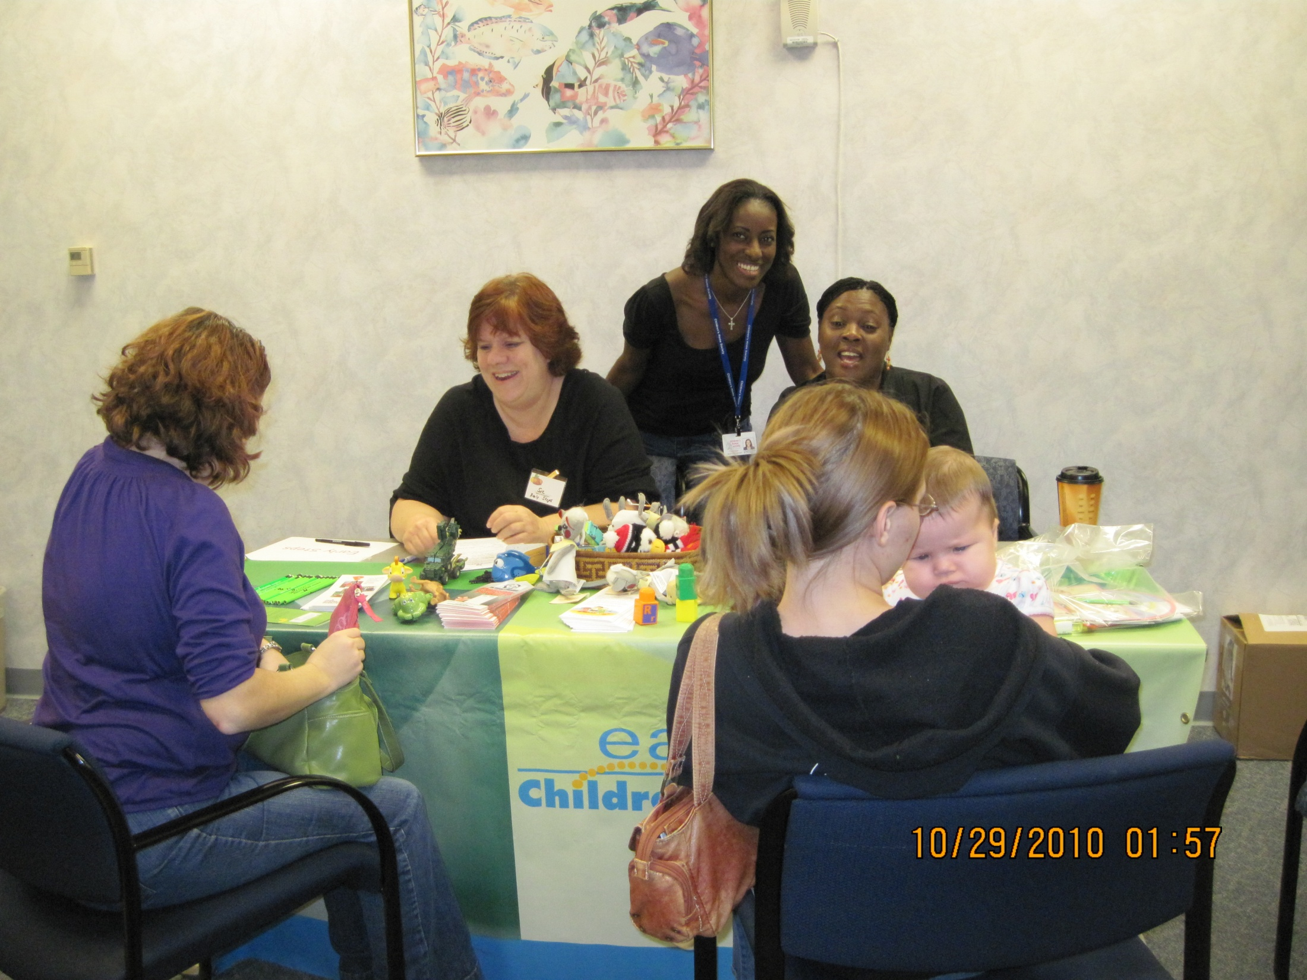
Thanks to our Community Screening Project Sponsors :
Children’s Medical Services – Whole Child Leon- Florida Diagnostic and Learning Resources System-Capital Area Chapter of the Florida Association for Infant Mental Health- Leon County Schools
Children’s Home Society Early Steps and Family Connections Programs- Early Learning Coalition- Brehon Institute for Family Services. Leon County Health Department, Dr. Edward Zapert-Dr. Jean Pierre Bastien of the local Dental Association

Slide 8
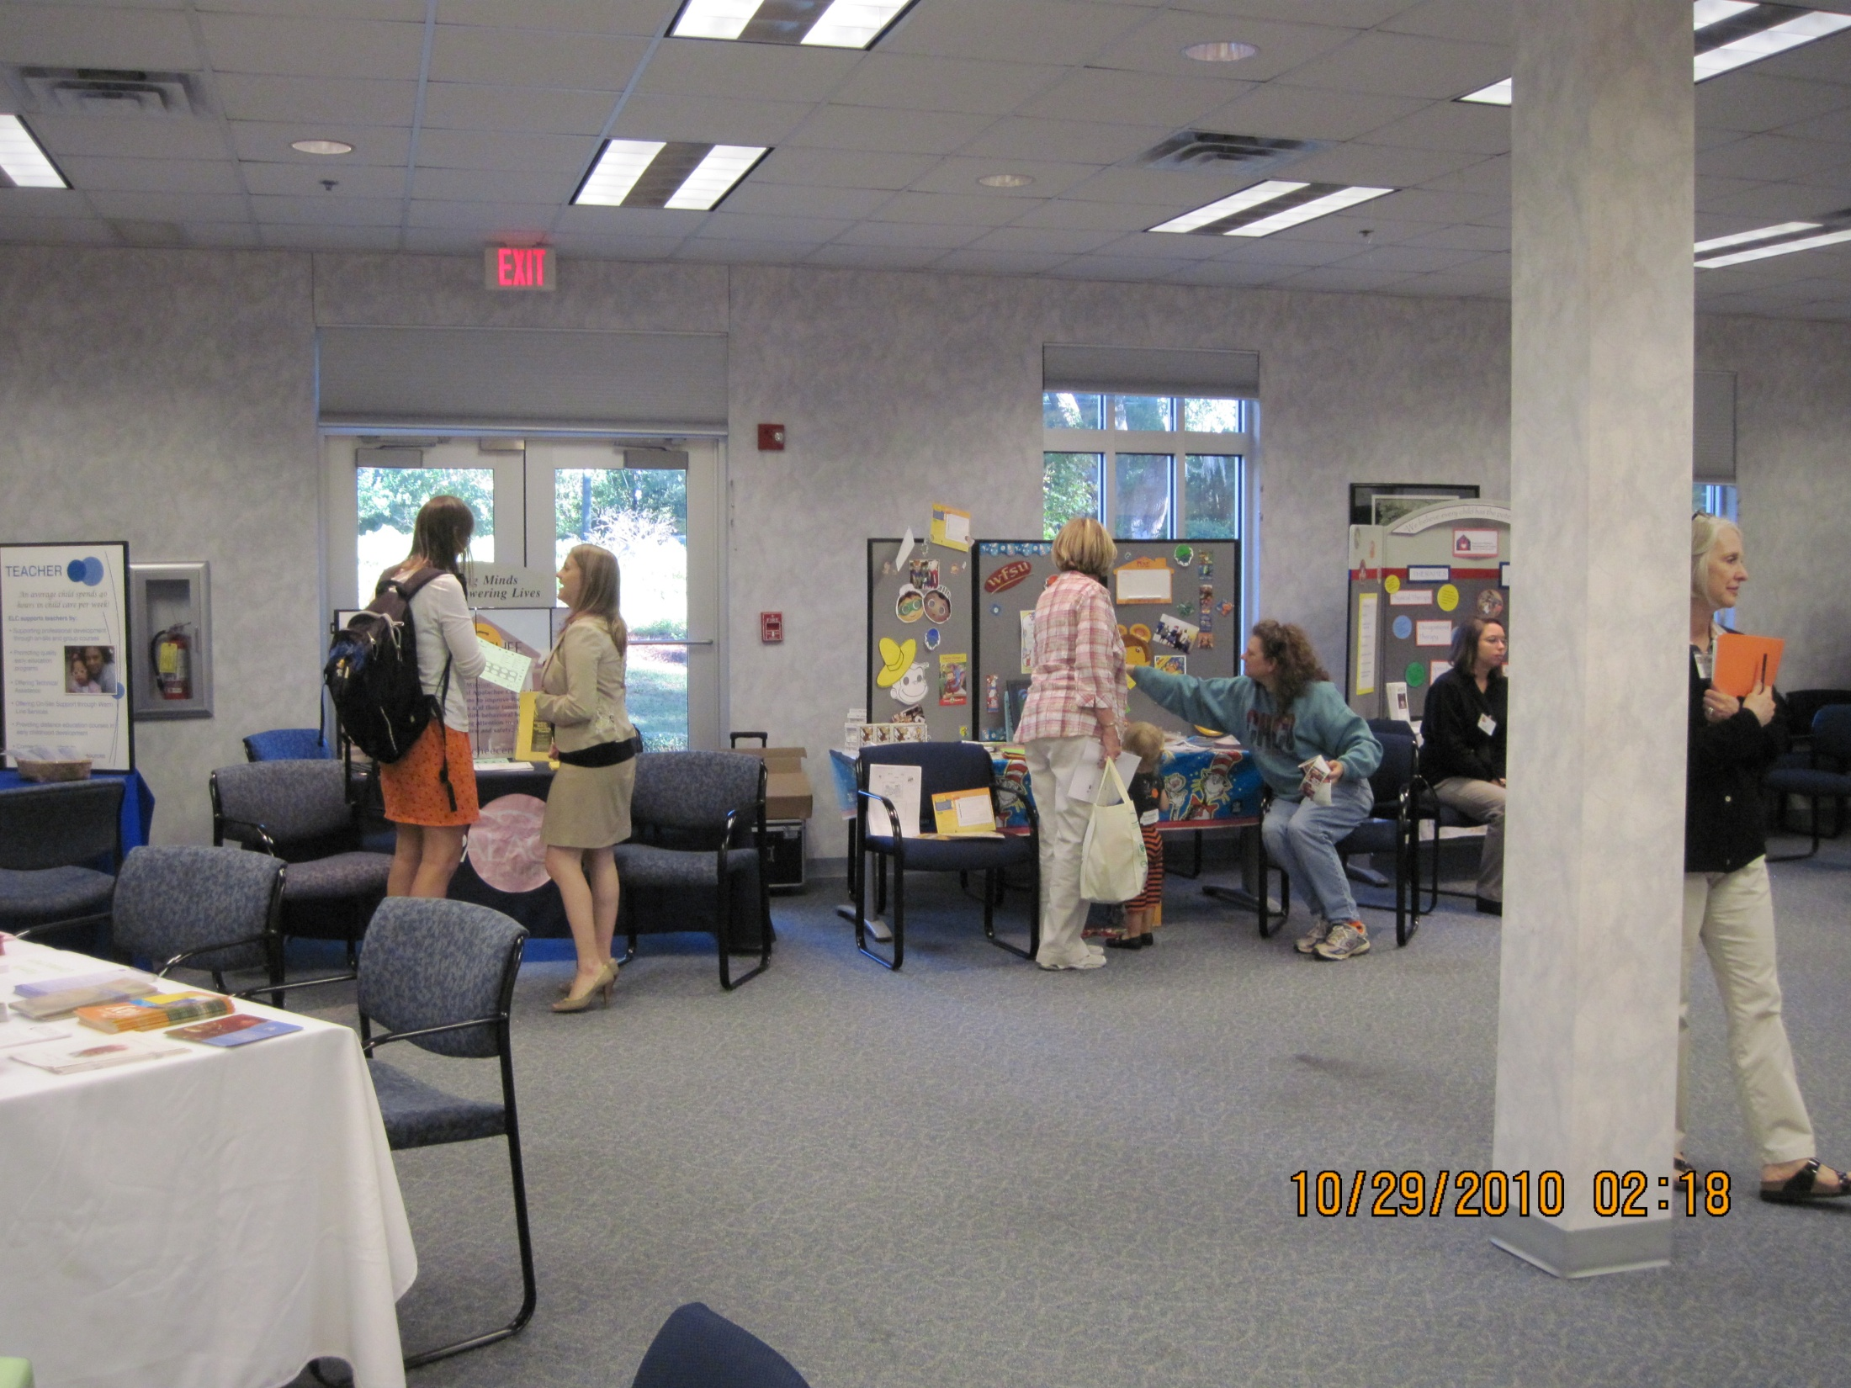
Thanks to our Community Screening Project Sponsors (Continue):
Florida State University: College of Communication Disorders- Autism Institute, First Words/CARD
Apalachee Mental Health Center-Department of Children and Families-Capital Area Healthy Start Coalition
United Way of the Big Bend–Kids Inc.-Technical Assistance and Training System Project-Tallahassee Community College-Early Head Start-Boys Town of North Florida
Tallahassee Democrat-WTXL-WCTV - Red Elephant

Slide 9
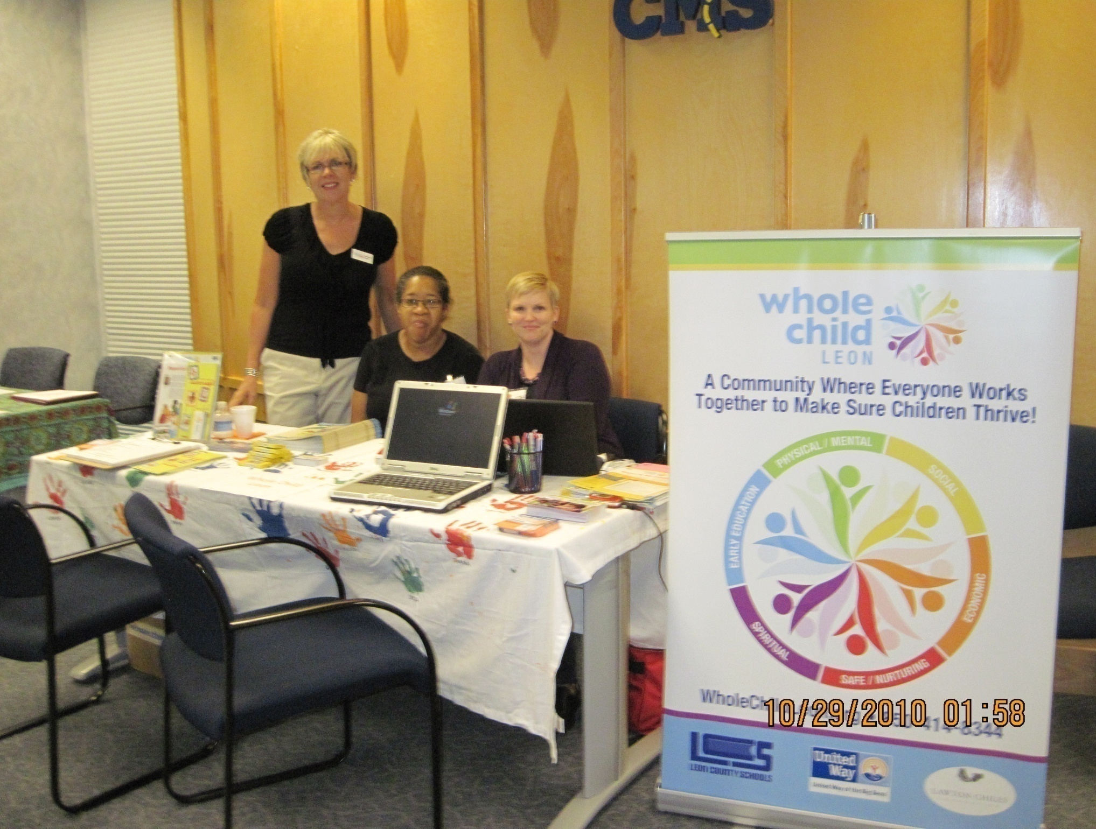
THANKS

